Slide 1

Pathology
Lecture 1
Introduction to pathology
and cell injury -1
Teaching Provider: Dr. Zain. MD
BLUE TEXT = EXTRA NOTES

Slide 2
General pathology course
* 22 lectures, two lectures per week.
* Major chapters:
1. Cell Injury, Cell Death, and Adaptations.
2. Inflammation and Repair.
3. Hemodynamic Disorders, Thromboembolism, and Shock.
4. Neoplasia.

Slide 3
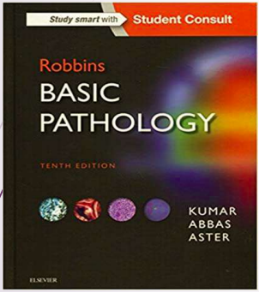
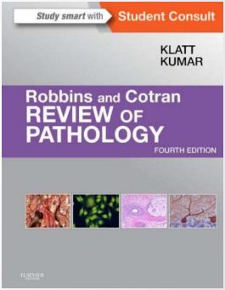
The books…

Slide 4
Introduction to pathology
* what is pathology ?
- Pathology : branch of medicine .
- The study of the structural & functional changes in cells, tissues, & organs that underlies diseases.
- It involves the examination of surgically removed organs, tissues (biopsy samples), bodily fluids, and, in some cases, the whole body (autopsy).

Slide 5
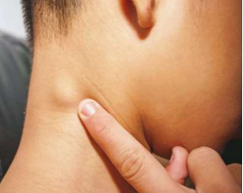
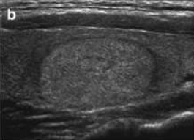
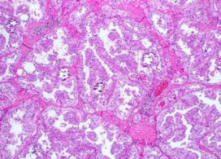
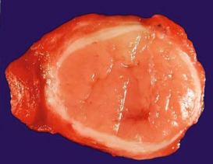

Slide 6
Classification Of Pathology
* General pathology :
Basic concepts that are shared among various disease in multiple organs/systems (Ex: Inflammation, cell injury and neoplasia )
* Systematic Pathology:
Discuss pathology of diseases of a specific organs/systems

Slide 7
* Anatomical pathology :
+Cytopathology +Dermatopathology
+Forensic pathology +Histopathology
+Neuropathology +Pulmonary pathology
+Renal pathology +Surgical pathology
* Clinical pathology :
+Hematopathology
+Immunopathology
+Radiation pathology
* Molecular pathology .

Slide 8
Pathology addresses components of disease :
1- • Cause: why ???
2- • Mechanisms of development (pathogenesis): how ???
3- • Structural alterations of cells (morphologic changes) ???
4- • The consequences of changes (clinical manifestations).

Slide 9
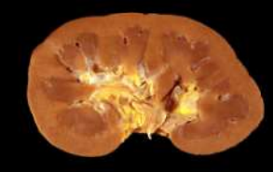
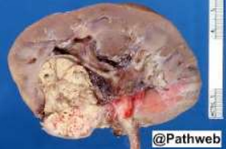
structural alterations of cells (morphologic changes): either by naked eye: Gross morphology

Slide 10
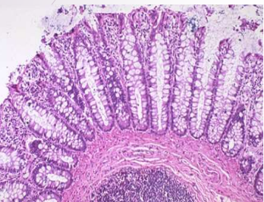
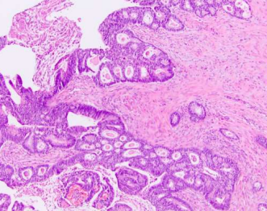
2. Morphology under microscope:
Microscopic
NORMAL COLONIC MUCOSA
COLON CANCER

Slide 11
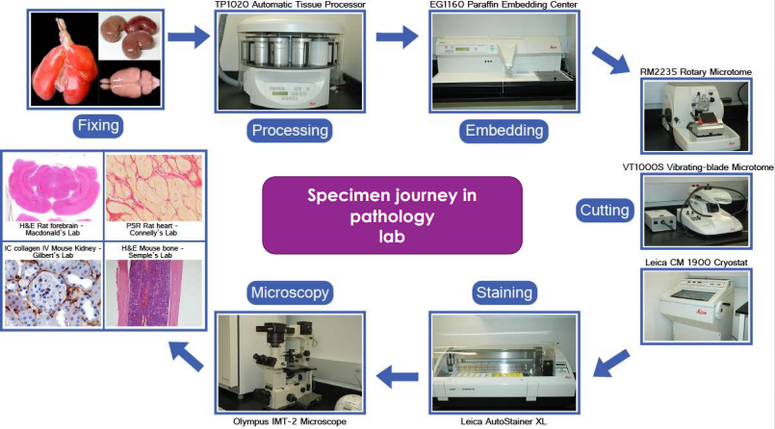
Formalin (formaldehyde) acts a preservative (fixative) preventing the autolytic decomposition of surgically removed human tissue

Slide 12
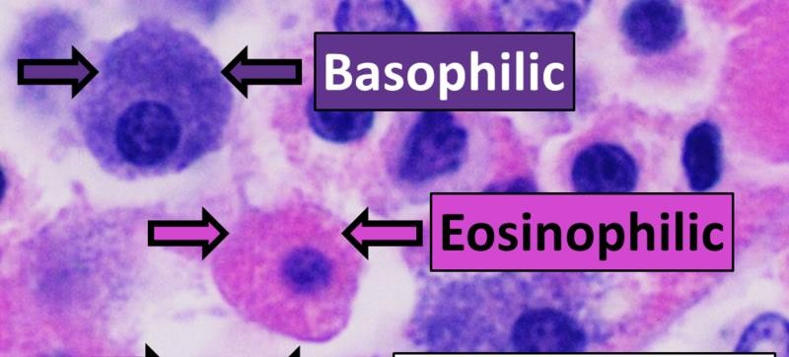
Normal cells in H&E stain
H&E is the combination of two histological stains: hematoxylin and eosin.
The hematoxylin stains cell nuclei a purplish blue, and eosin stains the extracellular matrix and cytoplasm pink

Slide 13
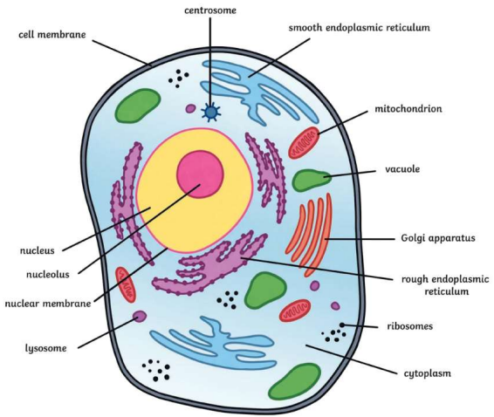
Cell injury -1
 Cells actively interact with their environment, constantly adjusting their structure and function to accommodate changing demands and extracellular stresses.
 The intracellular milieu of cells is normally tightly regulated such that it remains fairly constant, a state referred to as homeostasis.
- Nucleus : control of the genetical information of the cell.
- Mitochondrea : Cellular respiration.
- Lysosomes : Digestion of waste products within the cell.
- Rough endoplasmic reticulum : has on it ribosomes, which are small, round organelles whose function it is to make those proteins.

Slide 14
physiologic stresses (such as increased workload in the heart)
▪ potentially injurious conditions (such as nutrient deprivation).
The cells undergo adaptation: new steady state with preserving
viability and function.
If the adaptive capability is exceeded or if the external stress is
inherently harmful or excessive, cell injury develops

Slide 15
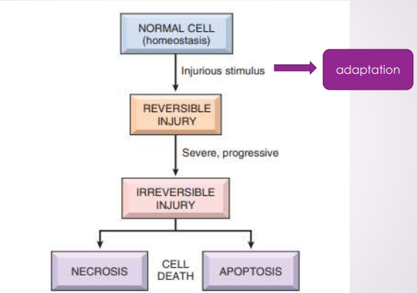

Slide 16
Causes of cell injury
• Oxygen Deprivation (Hypoxia Vs ischemia) : most common causes of injury
• Toxins: smoking, alcohol
• Infectious Agents
• Immunologic Reactions :autoimmune disease
• Genetic Abnormalities
• Nutritional Imbalances :
• Overintake: obesity, diabetes
• Insufficiency: protein, vitamins
• Physical Agents : trauma, burn
• Aging

Slide 17
Ischemia and Hypoxia
Ischemia is insufficient blood flow to provide adequate oxygenation , Usually caused by arterial thrombus formation or vasospasm.
Hypoxia : oxygen deficiency, can be caused by: Ischemia, anemia, lung disease, CO poisoning.

Ischemia results in hypoxia; however, hypoxia can occur with normal (or elevated) blood flow if, for example, the oxygen content of the arterial blood is decreased by anemia.

Slide 18
SEQUENCE OF EVENTS IN CELL INJURY AND CELL DEATH..
* Reversible Cell injury:
• the stage of cell injury at which the deranged function and morphology of the injured cells can return to normal if the damaging stimulus is removed
* Irreversible Cell injury:
• the stage of cell injury at which the injured cells pass a nebulous “point of no return” and undergo cell death.
• Occur if the stress is severe, persistent, or rapid in onset.

Slide 19
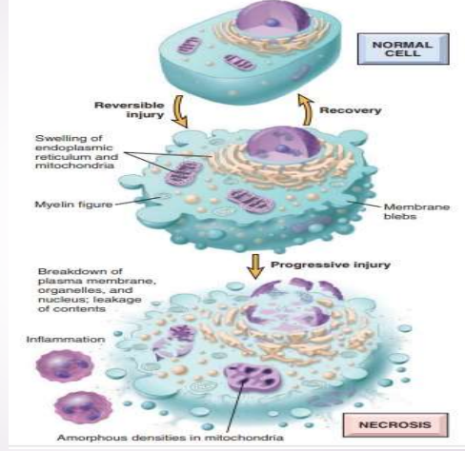
1. Reversible Cell injury:
Mitochondria is the earliest organelle affected in cell injury .

Slide 20
Morphological of reversible cell injury
1. Cellular Swelling
• Reversible process results from failure of the sodium potassium pump (energy-dependent ion pumps) due to ATP depletion.
❖
-Gross: pallor, turgor (stony hard) .
-Microscopy:
• Cellular swollen.
• hydropic change.

Slide 21
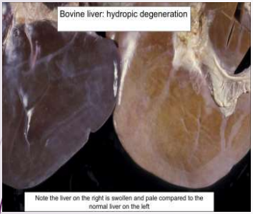
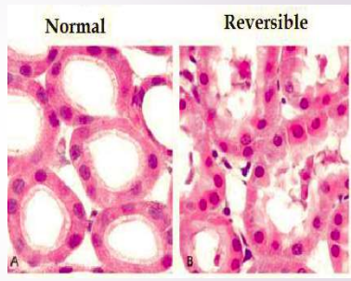
kidney tubules

Slide 22
2. Fatty change
It is reversible process, seen mainly in organs that involved in fat metabolism like Hepatocytes and myocardial cells .
Occurs mainly in hypoxic injury, toxic and metabolic injury.
Microscopy:
• lipid (triglyceride) vacuoles in the cytoplasm

Slide 23
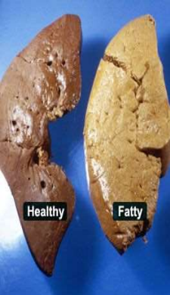
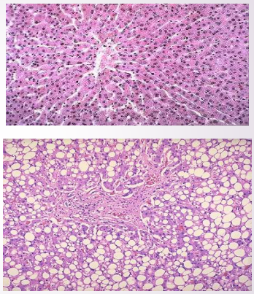

Slide 24
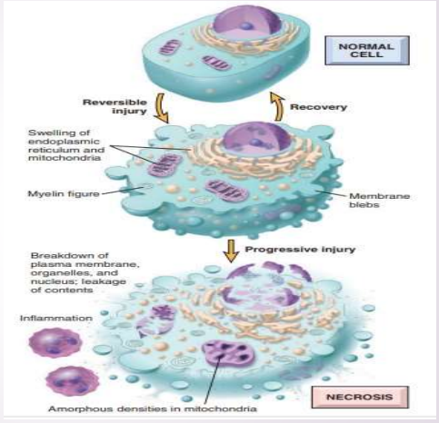
II. Irreversible cell injury

Slide 25
Irreversible cell injury consistently characterized by three phenomena:
1. The inability to restore mitochondrial function even after resolution of the original injury
2. Loss of structure and functions of the plasma membrane and intracellular membranes
3. Loss of DNA and chromatin structural integrity.

Slide 26
Depending on the nature and severity of the insult, cellular death may in form of:
1. Necrosis
2. Apoptosis
3. necroptosis

Slide 27


