Slide 1

Pathology
Lecture 2
Cell Injury and Necrosis -2
Dr.Eman Kreishan, M.D
Teaching Provider: Dr. Zain. MD
Blue = Extra notes

Slide 2
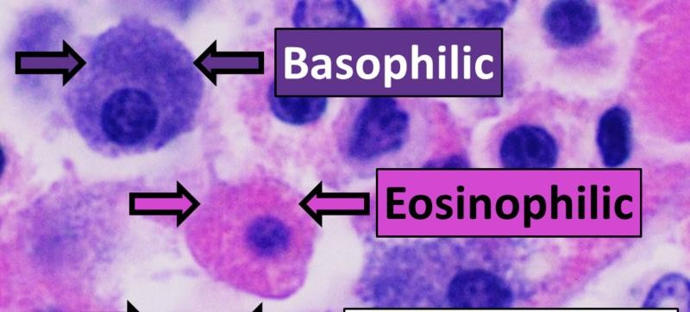
Normal cells in H&E stain
H&E is the combination of two histological stains: hematoxylin and eosin.
The hematoxylin stains cell nuclei a purplish blue, and eosin stains the
extracellular matrix and cytoplasm pink

Slide 3
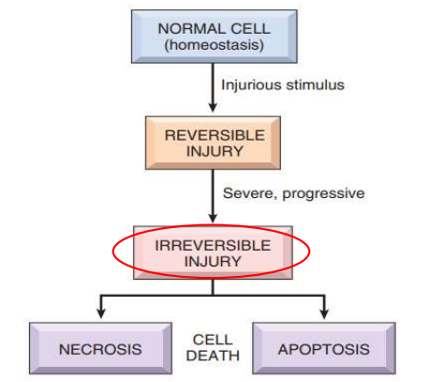

Slide 4
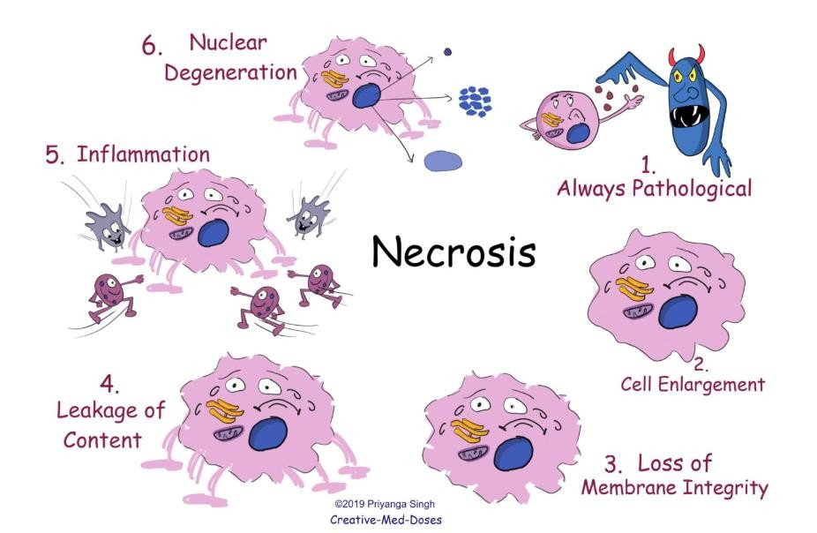
Necrosis
3
Drugs. Life online. Life.lk

Slide 5
Necrosis
It is an uncontrolled cell death that results in swelling of the cell organelles, plasma membrane rupture and eventual lysis of the cell, and spillage of intracellular contents into the surrounding tissue leading to tissue damage.
Considered as culmination of reversible cell injury that cannot be corrected.
Usually elicits a local host reaction, inflammation (due to the release of heat shock proteins, uric acid, ATP, DNA, and nuclear proteins).

Slide 6
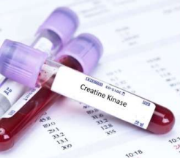
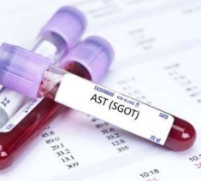
clinical importance
Leakage of intracellular proteins through the damaged cell membrane and ultimately into the circulation provides meanes of detecting tissue specific necrosis using blood of serum samples .

Slide 7
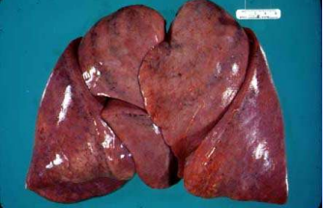
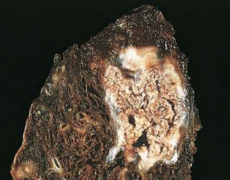
Morphological features of necrosis:
I. Grossly:

Slide 8
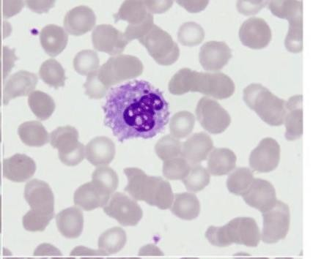
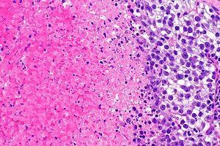
Microscopic appearance of Necrotic dead cells:
nuclear
cytoplasmic

Slide 9
Cytoplasmic :
* Increased Esosinophilia : increased binding of eosin to denatured cytoplasmic proteins, loss of basophilic ribonucleic acid (RNA) in the cytoplasm .
* A glassy, homogeneous appearance, mostly because of the loss of lighter staining glycogen particles.
* Cytoplasm vacuolated and appears “moth-eaten “, due to enzymes

Slide 10
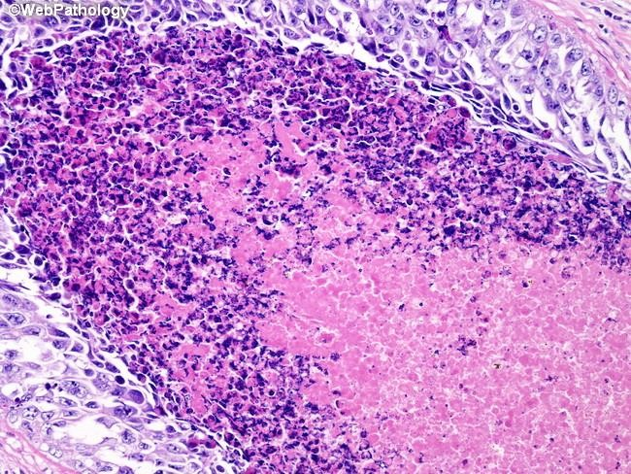

Slide 11
Nuclear changes
Due to break down of DNA; three patterns :
▪ Pyknosis: shrinkage and increased basophilia.
• Karyorrhexis: fragmentation of pyknotic nucleus
• Karyolysis: decrease basophilia of chromatin, DNAase: (deoxyribonuclease, DNA
digestion ).
In 1-2 days the nucleus in a dead cell may completely disappear.

Slide 12
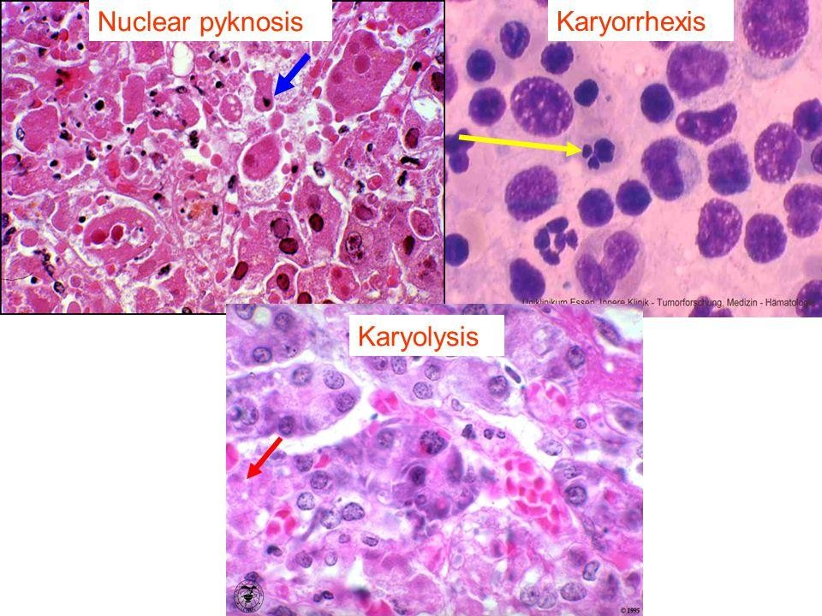

Slide 13
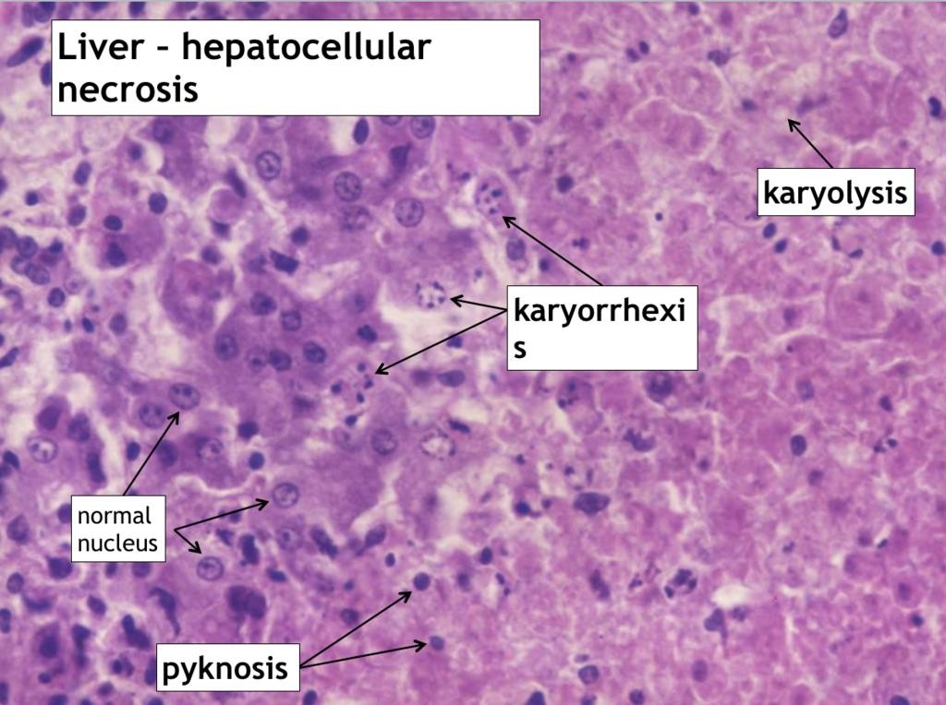

Slide 14
Morphologic Patterns of Necrosis
❖Coagulative necrosis
❖Liquefactive necrosis
❖Caseous necrosis
❖Fat necrosis
❖Fibrinoid necrosis

Slide 15
1. Coagulative necrosis
proteins can denature (coagulate) to leave ‘ghost’ outlines behind. The dead cells lose their nuclei and may stain more intensely.
The most common form of necrosis (particularly in myocardium, liver, kidney)
characteristic of hypoxic cell death in all tissues except in the brain

Slide 16
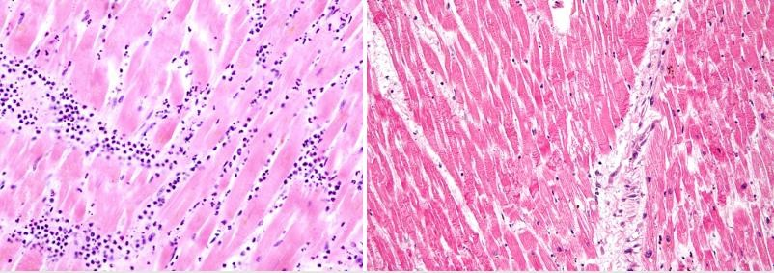
coagulative necrosis in the myocardium after infarction

Slide 17
2. Liquefactive necrosis
* Infiltration of dead tissue by large numbers of neutrophils leads to digestion of cell proteins. This leads to loss of normal tissue architecture and is known as liquefactive necrosis.
*Liquefactive necrosis is common after cell death in lipid rich tissue such as the brain (cerebral infarction).

Slide 18
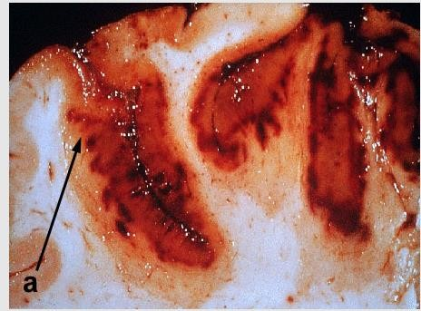
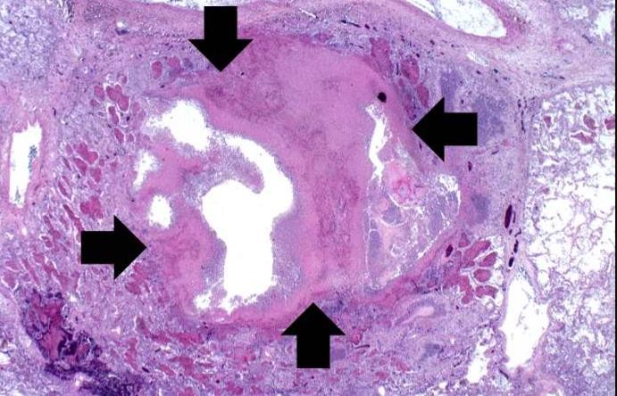
Liquefactive necrosis

Slide 19
3. Caseous necrosis
*Granulomas are aggregates of epithelioid macrophages and giant cell macrophages, often surrounded by lymphocytes.
*Granulomas are found as a response to foreign bodies, in some autoimmune diseases, and in mycobacterial infection (e.g. M.tuberculosis).
*Necrosis can occur in the center of granulomas, typically in mycobacterial infection. This is described as caseous necrosis because the macroscopic appearance was considered to be cheese-like.

Slide 20
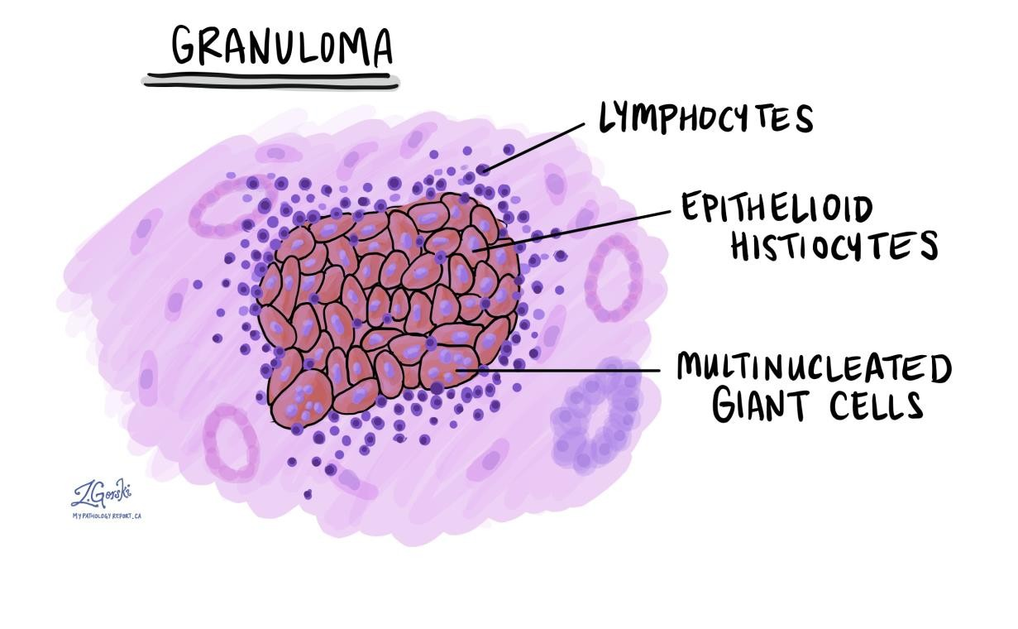
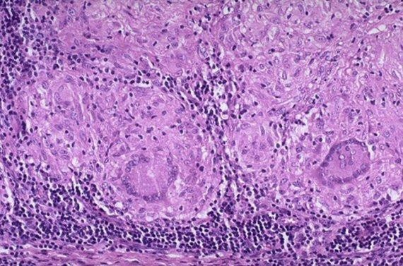
Caseous necrosis

Slide 21
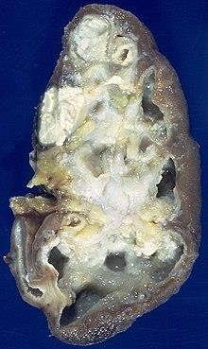
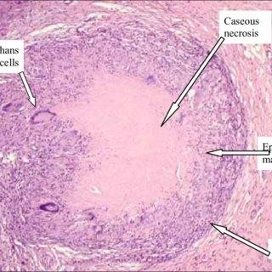
Caseous necrosis

Slide 22
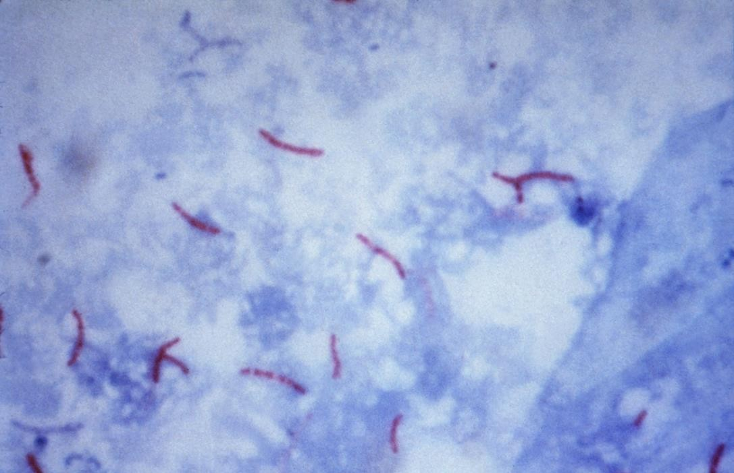
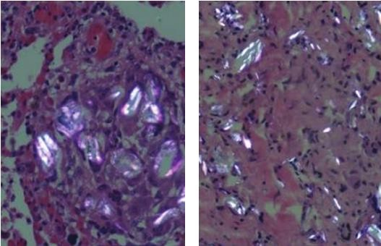
Caseous necrosis
M.tuberculosis
foreign bodies

Slide 23
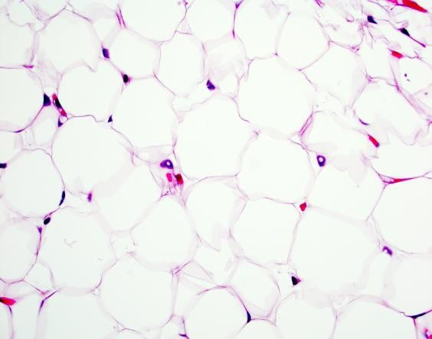
4. Fat necrosis :
* A pattern of necrosis that occurs due to degradation of fatty tissue by lipases (released from dead cells) to form chalky deposits.
*This can be seen in acute pancreatitis (acute inflammation of the pancreas causing necrosis of pancreatic acinar cells and lipase release), or from trauma to fatty tissues.
**Fatty acids bind and precipitate calcium
ions, forming insoluble salts.

Slide 24
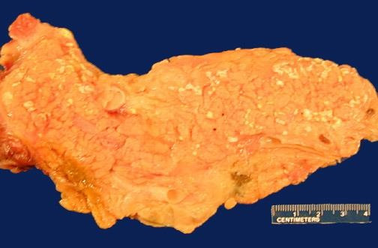
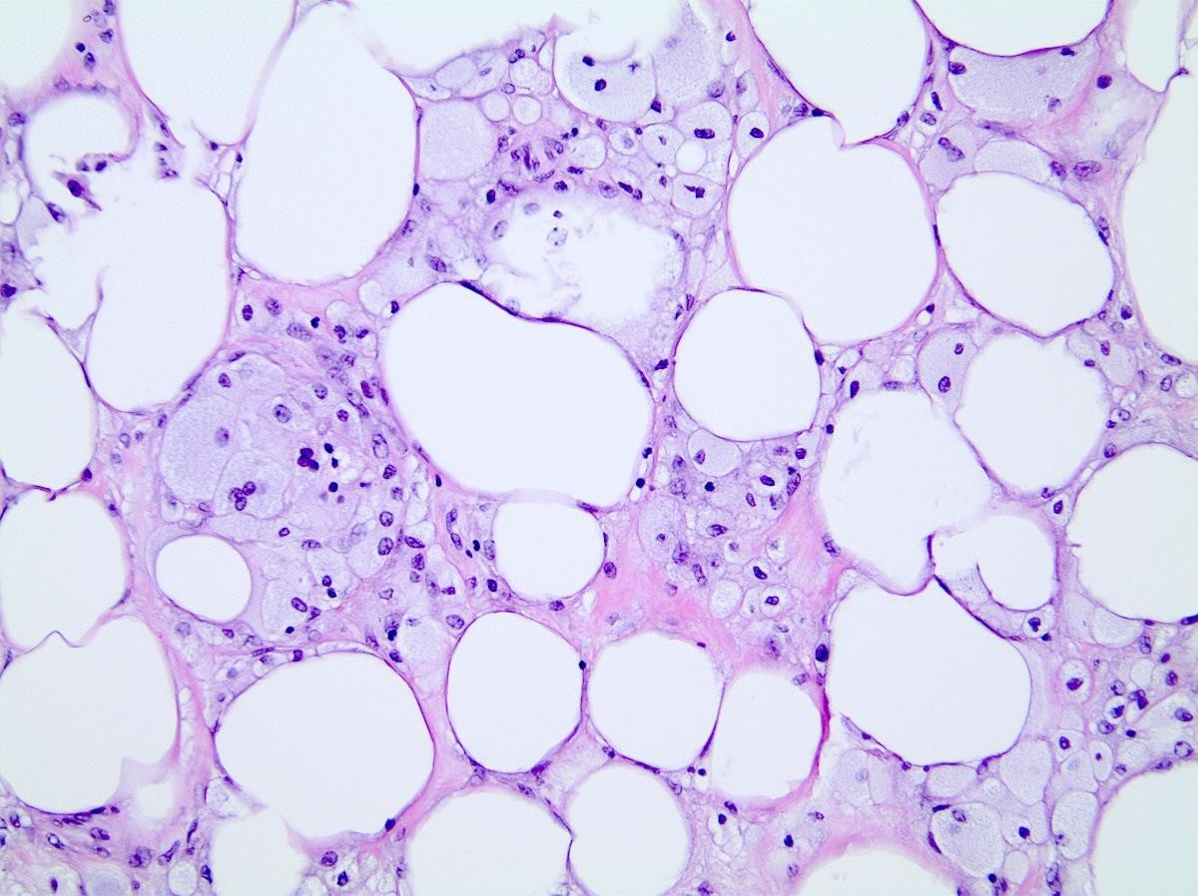
Fat necrosis
Fatty acids bind and precipitate calcium
ions, forming insoluble salts.
* foamy macrophages adjacent to adipose tissue

Slide 25
5. Fibrinoid necrosis
* In immune reactions: complexes of antigens and antibodies are deposited in the walls of blood vessels.
* In Severe hypertension.
* Deposited immune complexes and plasma proteins that leak into the wall of damaged vessels produce a bright pink, amorphous appearance (fibrin)

Slide 26
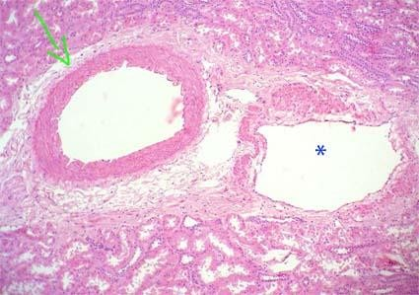
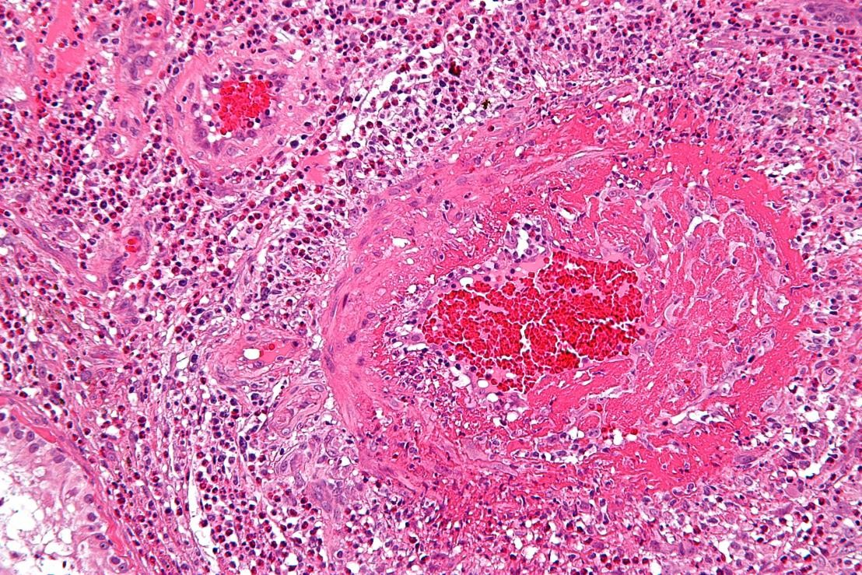
Fibrinoid necrosis
Normal B.V
Fibrinoid necrosis

Slide 27
FATE OF NECROSIS
- Most of necrotic tissue os removed by leukocytes (phagocytosis) combined with extracellular enzyme digestion .
-If necrotic tissue is not eleminated , it attracts Ca++ salts ---- dystrophic calcification .

Slide 28


